Slide 1

CSE0613-2201 System Analysis & Design
Systems Analysis and Design
Partho Sarathi Sarker
Asst. Professor
Dept. of Computer Science and Engineering(CSE)
University of Global Village (UGV)

Slide 2
Week 5,6 Differences between System Analysis and System Design, Role of System Analyst, Qualities of the System Analyst,

Slide 3

Differences between System Analysis and System Design
System analysis and system design are two critical phases in the development lifecycle of a software system. While they are often used interchangeably, they serve distinct purposes and involve different methodologies.

Slide 4
Differences between System Analysis and System Design
System Analysis
System analysis is the initial phase of a software development project where the requirements of the system are gathered, analyzed, and documented. It involves understanding the problem domain, identifying the stakeholders, and defining the scope and objectives of the system.
Key Activities in System Analysis
Requirement Gathering− Identifying the needs and expectations of the users and stakeholders.
Requirement Analysis− Analyzing the gathered requirements to ensure consistency, feasibility, and completeness.
Feasibility Study− Assessing the technical, economic, and operational feasibility of the proposed system.
Process Modelling− Creating diagrams and models to represent the current and proposed business processes.
Data Modelling− Defining the data entities, attributes, and relationships within the system.

Slide 5
Role of System Analyst
The analyst plays a key role in information system development projects.
Must understand how to apply technology to solve business problems
Analyst may serve as a change agents who identify the organizational improvement

Slide 6
Qualities of the System Analyst
Problem solver
Communicator
Strong personal and professional ethics
Self-disciplined and self -motivated

Slide 7
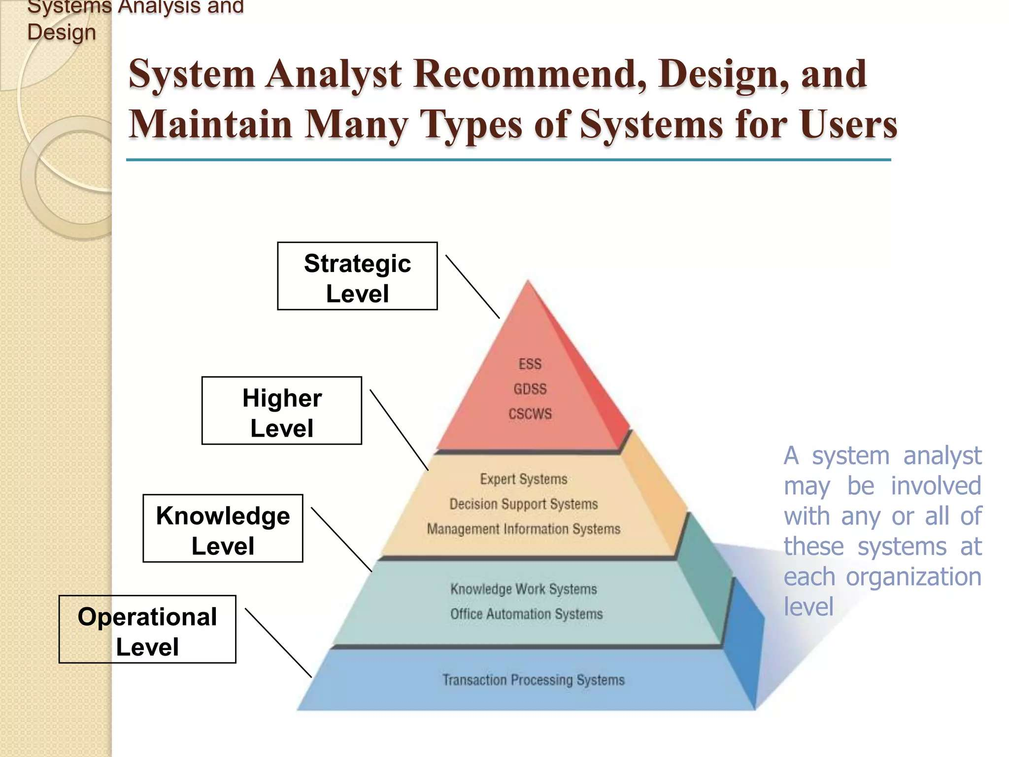

Slide 8
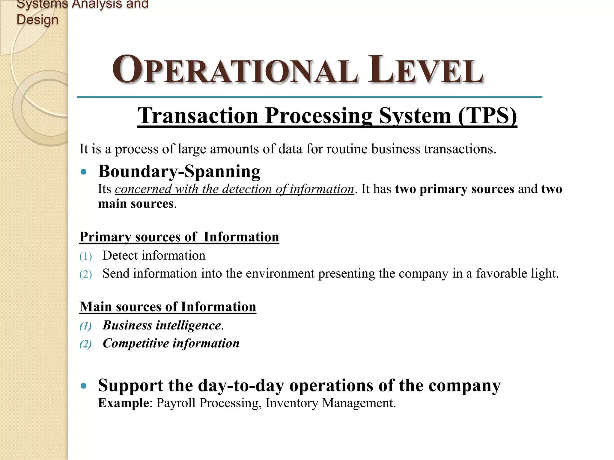

Slide 9
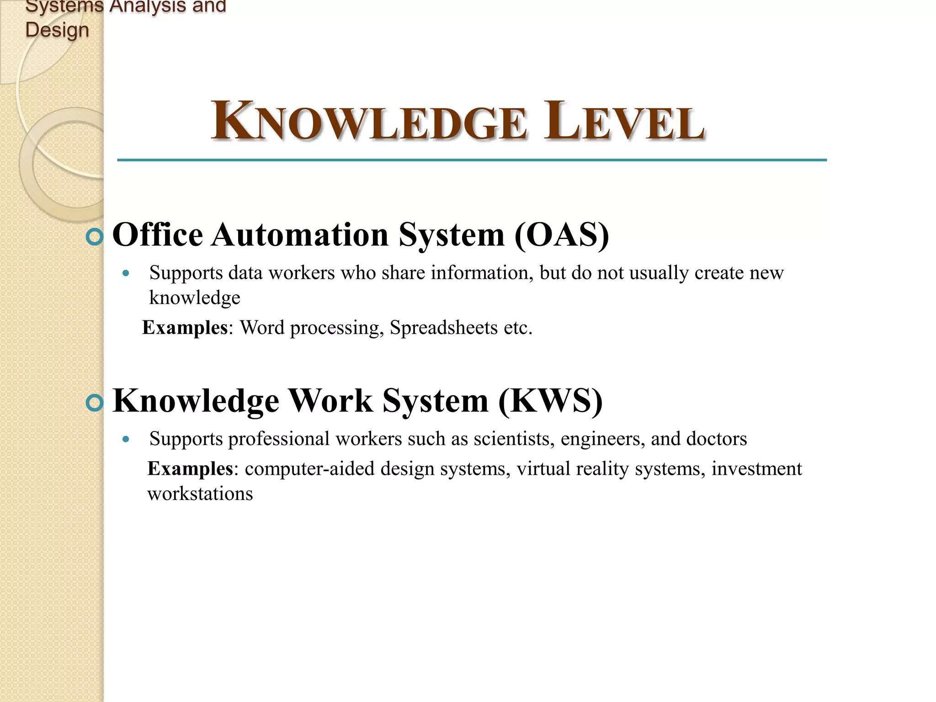

Slide 10


Slide 11
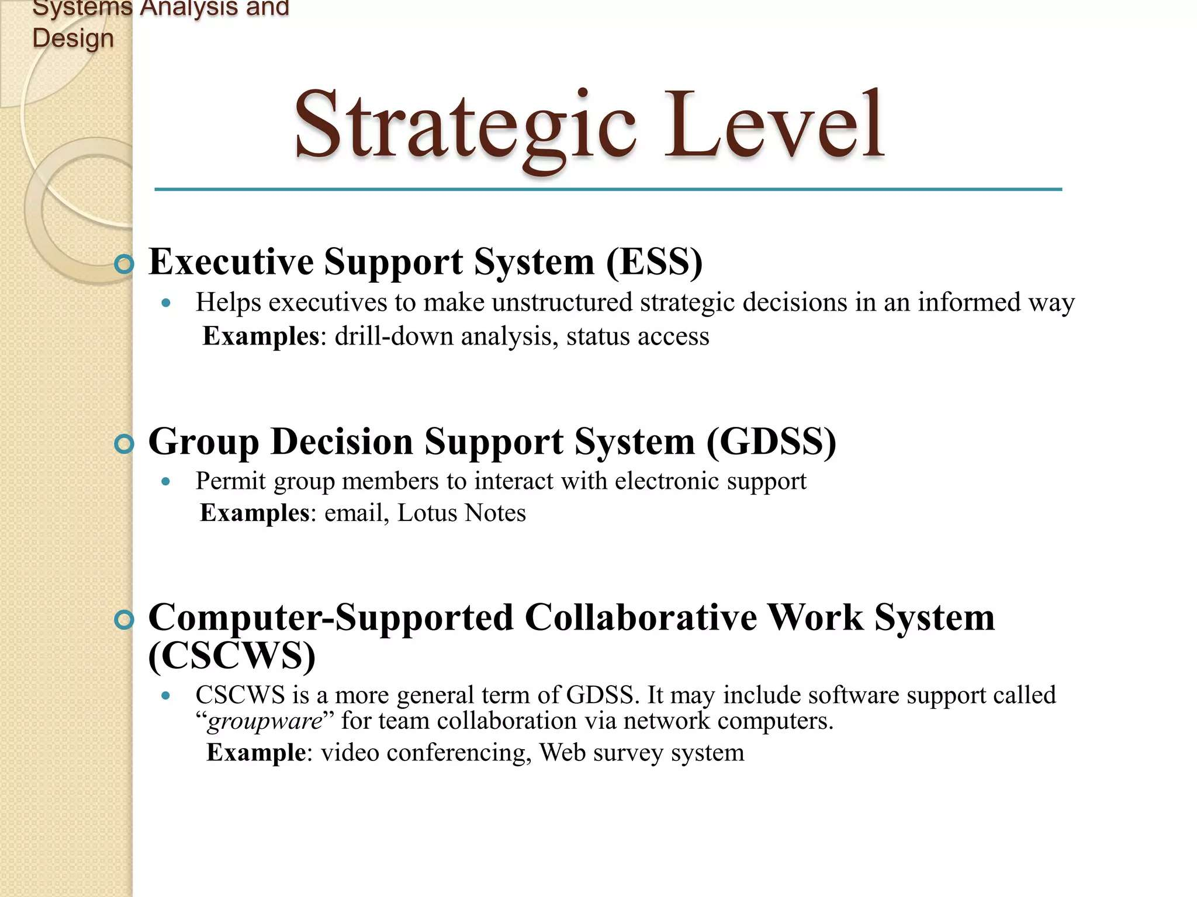

Slide 12
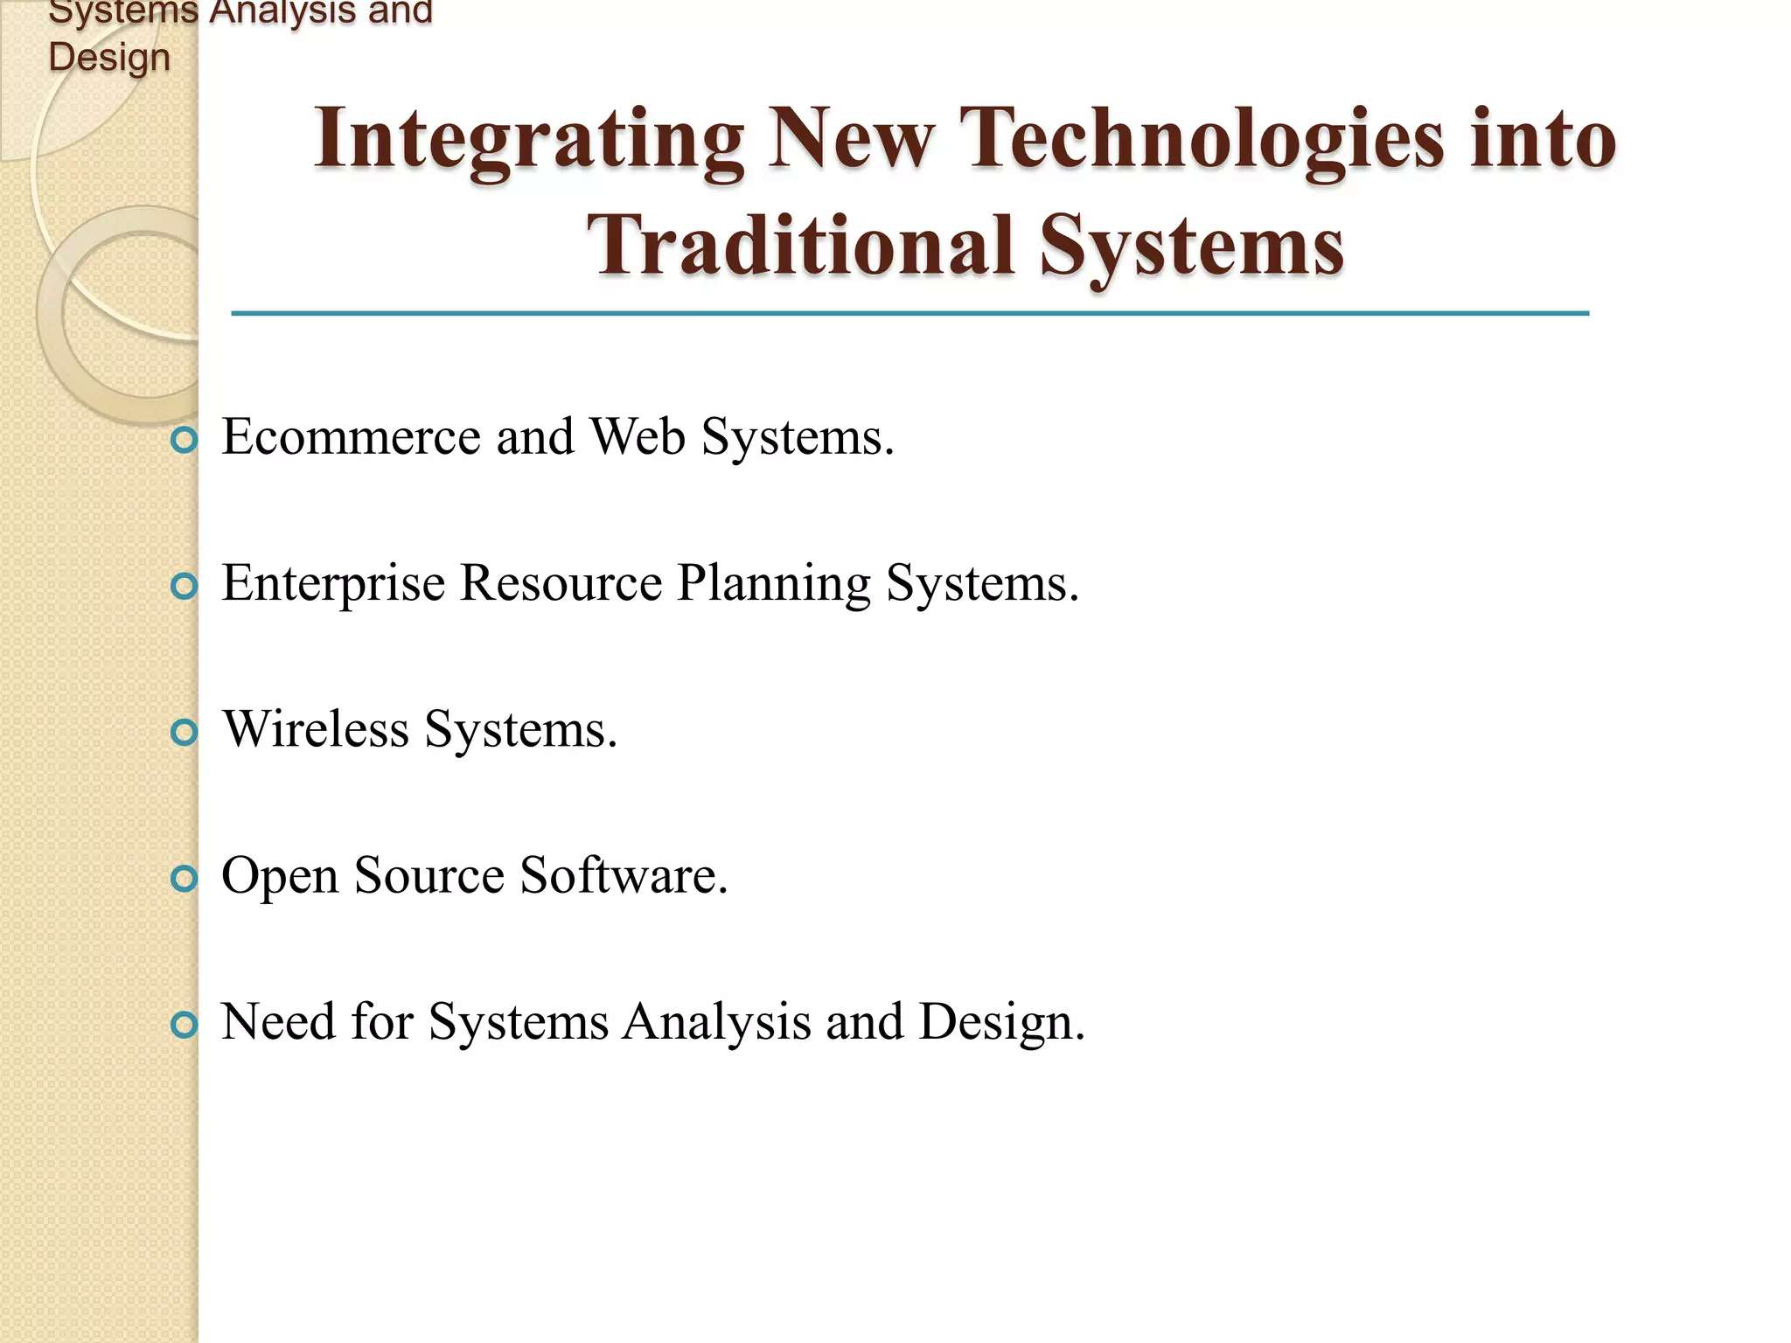

Slide 13
